Slide 1
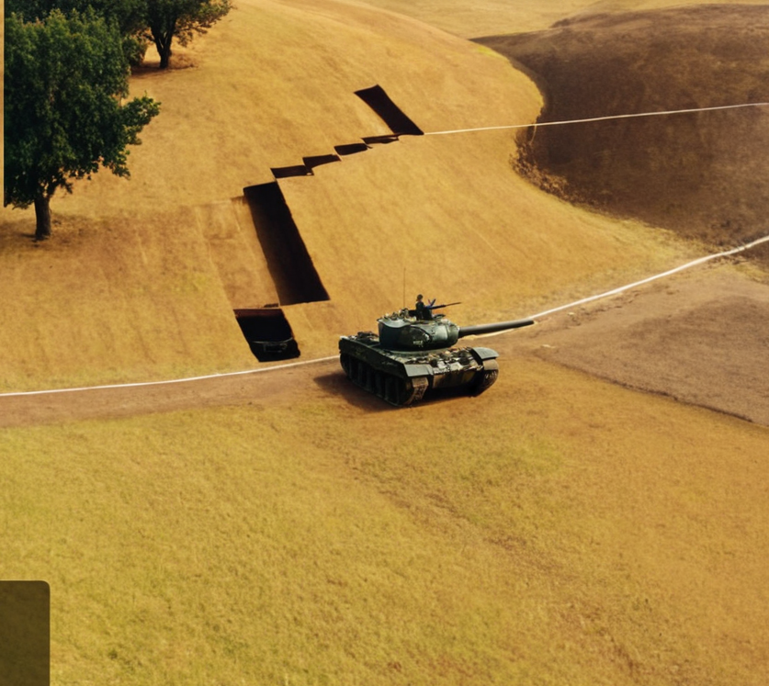
Ares Team
Tank wars
KORNEL
KRZYSZTOF
TITAS
OMNI

Slide 2
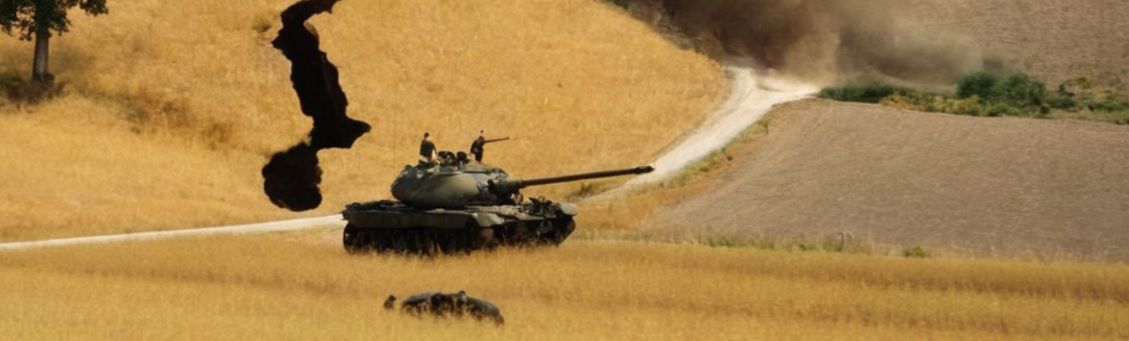
AI Techniques
…

Slide 3
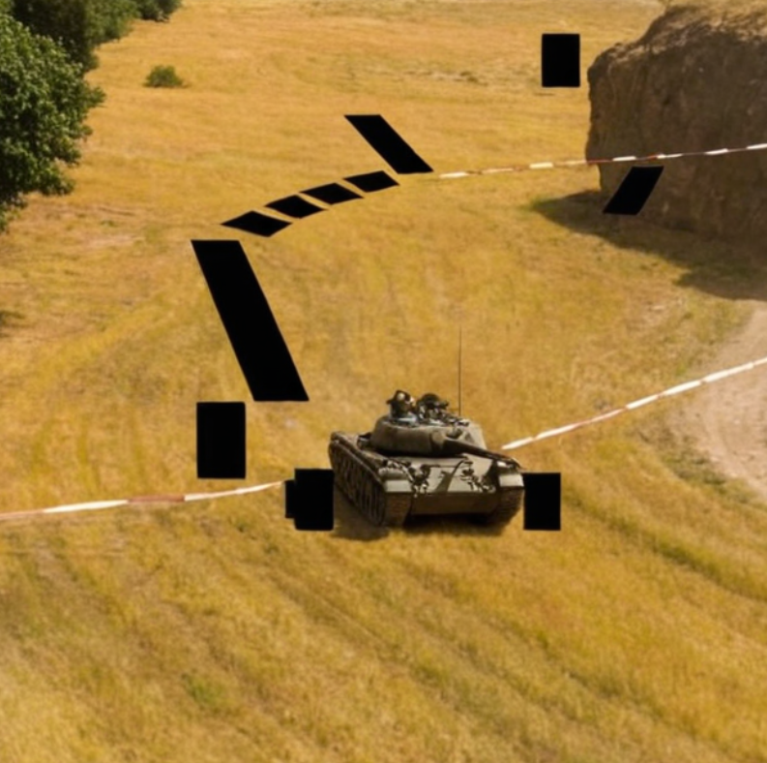
Intended behaviour
You can write about your theme here.
You can explain why you chose the theme.
The goal is to be light-hearted, playful, and funny

Slide 4
FSM Stages
Picture #1
Picture #2
Picture #3

Slide 5
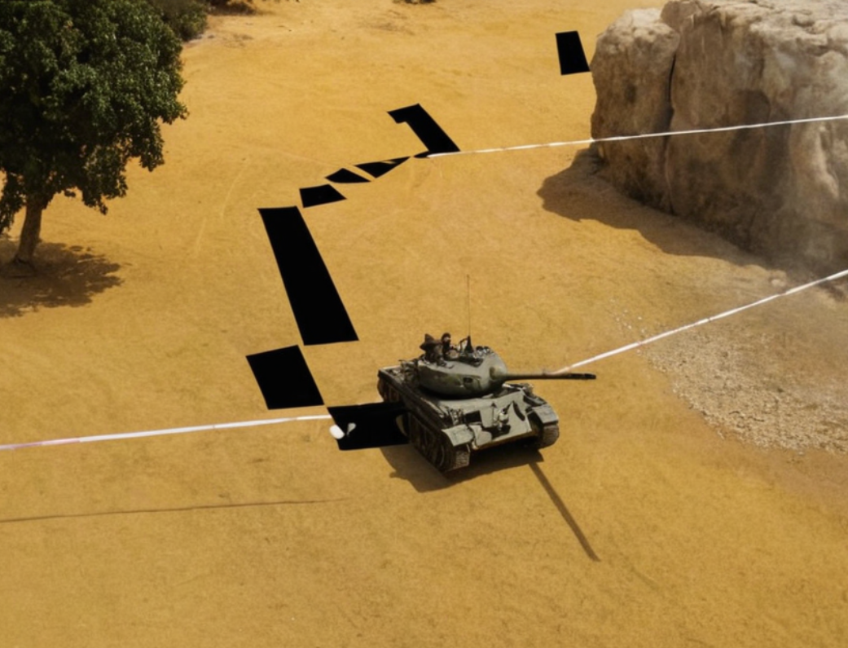
THEME INFO
You can write about your theme here.
You can explain why you chose the theme.
The goal is to be light-hearted, playful, and funny

Slide 6
Add Video

Slide 7
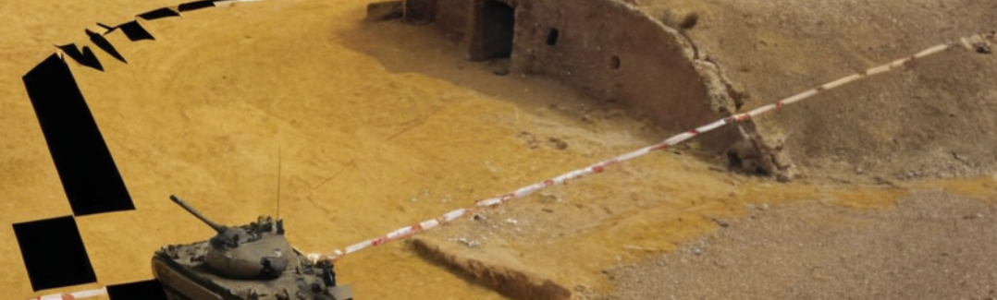
Something
Subtitle goes here

Slide 8
Choose a theme
Your theme can be anything you want. Here are some examples to start:
Explain why [subject] is your favourite film.
Teach about a famous person in history.
Introduce the group to your hidden talent.

